Slide 1
Housing Trust Fund of Santa Barbara County
Workforce Homebuyer
Down Payment Program
“We build community partnerships and financial resources to expand workforce and affordable housing opportunities”.

Slide 2
Housing Trust Fund of Santa Barbara County
Our mission is to expand affordable and workforce housing opportunities.
Countywide 501 (c) (3) nonprofit loan fund.
We operate housing affordable production and homebuyer assistance programs.
Community Development Financial Institution (CDFI) certified by the U.S. Treasury CDFI Fund.
HUD Certified Secondary Loan Provider.

Slide 3
Workforce Homebuyer Program Goals
Expand access to the private housing market.
Help local employees purchase an entry-level home.
Provide low-cost down payment resources to overcome barriers to
homeownership.
Achieve Conventional Financing (20% down payment) to avoid expensive FHA mortgage insurance.
Create a revolving Workforce Housing Fund with local lending partners to provide financial resources now and in the future to assist local employees.

Slide 4
South Coast Workforce Homebuyer Program
Interest-only down payment loans up to 16.5% of the home purchase price or a maximum loan of $100,000.
Fixed rate currently at 4.50% simple annual interest (borrowers can make principal payments at any time).
Loan is due at the end of 10 years* and is repaid through refinancing or taking out a home equity loan.
We have raised a $3.8 million capital pool to make an initial 38 loans.
* Loans to purchasers of affordable resale restricted homes have a 15-year term.

Slide 5
Homebuyer Qualifications Summary
First-time homebuyers: Cannot have owned a home in the past three years and may not own other residential property (some exceptions).
Residency: U.S. citizen, naturalized citizen or legal alien resident who works in Santa Barbara County.
Homebuyer Education: Borrowers must complete a Homebuyer Education Program with one of our community partners.
Eligible Household: Income may not exceed 210% of Area Median Income, adjusted for household size. [Household Income must be certified.]
First Mortgage Pre-approved: 30-year or 15-year fixed rate First Mortgage from a participating lender.
Homebuyer Equity: Must contribute a minimum 3.5%* of the home purchase price and invest other liquid assets in excess of $30,000.
Documented gift funds up to 2.5% of the required 3.5% are allowed; the homebuyer must contribute a minimum of 1% of funds.

Slide 6
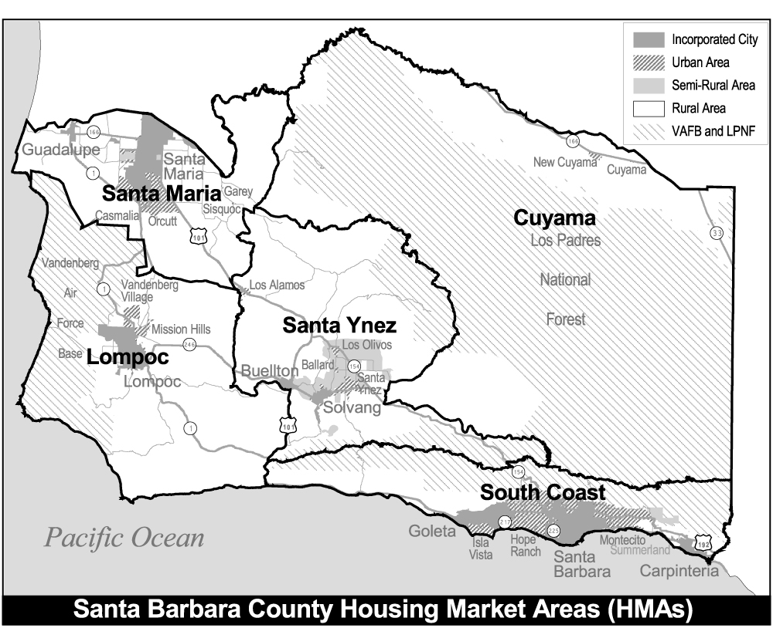
Eligible Homes and Market Area
Homes:
Market rate single-family
Townhomes and condominiums
PUD units
Resale restricted affordable homes
Market Area
Carpinteria to Gaviota
Buellton, Solvang and Santa Ynez and immediate surrounding areas

Slide 7
South Coast Workforce Homebuyer Program Maximum Household Incomes
Household Size | Maximum Income*
1 to 4 persons | $184,400
5 to 8 persons | $243,400
Resale restricted homes will have traditional income limitations based on household size. Check with the local jurisdictions.
* Based on the Area Median Income , which is set by HUD annually

Slide 8
Other Requirements & Issues
No co-signers on the loan; all borrowers must occupy the home for the duration of the loan.
HTF requires a Home Inspection Report.
We follow FHA standard for 2-years remaining roof life.
We require health and safety problems to be fixed prior to loan closing.
We highly recommend a 45-day escrow period.
Homebuyers employed by members of the Coastal Housing Partnership are eligible for discounts.

Slide 9
Borrower Steps for Obtaining a Loan
Step 1: Complete a Homebuyer Education Course
Step 2: Obtain Pre-approval of a First Mortgage Loan
Step 3: Complete your Income Certification (need lead time)
Step 4: Work with your Realtor to locate your home and execute a sales contract (contingent on approval of your loans)
Step 5: Submit your Down Payment Loan Application and supporting documentation to the First Mortgage Lender
Step 6: Receive your Down Payment Loan commitment
Step 7: Escrow (45-days preferred) and Loan Closing - review and sign loan documents

Slide 10
Workforce Homebuyer Example*
Family of Three
Annual Household Income $136,500
Home Type: 3 Bedroom 2.5 Bath Condo
or small home
1100 – 1500 sq. ft.
Home Purchase Price: $655,000
* Financial model only, not an actual loan transaction.

Slide 11
Homebuyer Housing Costs
Model: Family of Three
Annual Income = $136,500
Percentage of AMI = 192%
Home Price = $655,000
Notes:
Over the past several decades home prices and rents have risen dramatically in Santa Barbara County.
Despite the recent housing market downturn, homes remain beyond the purchasing ability of the majority of working families.
In 1983 the median priced home in Santa Barbara was 4 times the median income; by 2008 the median priced home was 12 times the median income.
Our workforce is priced out of the community they serve.

Slide 12
Loan Repayment Model
Two options: refinance or home equity loan
Assumes modest average income increase, higher future interest rates
Does not rely on home appreciation
Percentage of homebuyer income for housing stable

Slide 13
The Workforce Homebuyer Program Serves a Variety of Household Incomes and Home Prices
14 Loans closed to date.
Average down payment loan amount is $78,730
Average home purchase price has been $522,730 overall
$608,790 for market rate homes ($133,700 to $800,000)
Affordable units have lower prices and lower household
qualifying incomes. We have funded 4 loans for families and
individuals who purchased affordable homes.

Slide 14
Program Benefits
Low interest, fixed rate for 10 years (15 years for affordable)
Achieve a 20% down payment and conventional financing and
avoid expensive FHA insurance costs
Helps employees buy an entry-level home in the community and
live closer to work.
Helps employers attract and retain quality employees, save on
training costs and enhance employee productivity.
Contributes to a vibrant local economy & sustainable community.
“When people can afford to live where they work, we all benefit from high quality community services, a strong local economy, strong local schools and supportive intergenerational families that foster the next generation of the workforce”.

Slide 15
Application Process
We are available to answer your questions and help you better understand:
Eligibility Requirements and household income limits;
How to connect with First Mortgage lenders participating in the
program;
How to apply for our down payment loan; and,
Where to take the Homebuyer Education class and have your
household income certified.

Slide 16
For More Information Contact Yvette Lounsbury at:
Housing Trust Fund of Santa Barbara County
P. O. Box 60909
Santa Barbara, CA 93160-0909
(805) 845-3585
Ylounsbury@sbhousingtrust.org
www.sbhousingtrust.org

Slide 17
Program Information
Download Program Guidelines, Loan Flyers and a Homebuyer’s Orientation Packet at:
https://www.sbhousingtrust.org/programs/workforce-homebuyer-program
Contact Yvette Lounsbury, Homebuyer Loan Administrator at (805) 845-3585 or Ylounsbury@sbhousingtrust.org

